Slide 1
Competitive Programming
The 2nd Session
12 Aug. 2022
Andrei Novikov

Slide 2
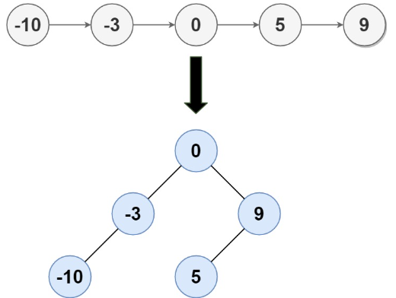
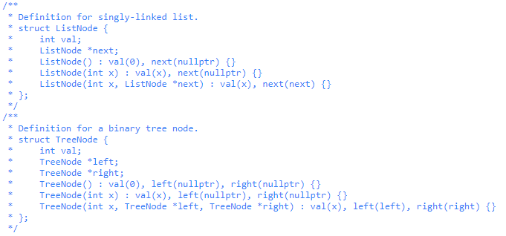
Challenge #1
Given the head of a singly linked list where elements are sorted in ascending order, convert it to a height balanced BST.
For this problem, a height-balanced binary tree is defined as a binary tree in which the depth of the two subtrees of every node never differ by more than 1.

Slide 3

Challenge #1 – Time to Think
Time to Think (5 minutes)

Slide 4
Challenge #1 - Think
Given the head of a singly linked list where elements are sorted in ascending order, convert it to a height balanced BST.
For this problem, a height-balanced binary tree is defined as a binary tree in which the depth of the two subtrees of every node never differ by more than 1.

Slide 5
Challenge #1 – Implementation
The following syntax is proposed to solve the problem:
class Solution {
public:
TreeNode* sortedListToBST(ListNode* head) {
}
};
Share Screen and Solve the Problem

Slide 6

Warm-Up – Challenge #1 - Submit
Problem origin: LeetCode
Complexity: Medium
Link to Submission: https://leetcode.com/problems/convert-sorted-list-to-binary-search-tree/submissions/

Slide 7
Challenge #2
Given two strings s and t, return true if t is an anagram of s, and false otherwise.
An Anagram is a word or phrase formed by rearranging the letters of a different word or phrase, typically using all the original letters exactly once.
Example 1:
Input: s = "anagram", t = "nagaram"
Output: true
Example 2:
Input: s = "rat", t = "car"
Output: false
Constraints:
1 <= s.length, t.length <= 5 * 104
s and t consist of lowercase English letters.

Slide 8
Challenge #2 – Time to Think
Time to Think (5 minutes)

Slide 9
Challenge #2 – Think
Given two strings s and t, return true if t is an anagram of s, and false otherwise.
An Anagram is a word or phrase formed by rearranging the letters of a different word or phrase, typically using all the original letters exactly once.
Example 1:
Input: s = "anagram", t = "nagaram"
Output: true
Example 2:
Input: s = "rat", t = "car"
Output: false
Constraints:
1 <= s.length, t.length <= 5 * 104
s and t consist of lowercase English letters.

Slide 10
Challenge #2 – Implementation
The following syntax is proposed to solve the problem:
class Solution {
public:
bool isAnagram(string s, string t) {
}
};
Share Screen and Solve the Problem

Slide 11
Warm-Up – Challenge #2 - Submit
Problem origin: LeetCode
Complexity: Easy
Link to Submission: https://leetcode.com/problems/valid-anagram/submissions/

Slide 12




Where to Practice
LeetCode [link]
HackerRank [link]
Kattis [link]
TopCoder [link]
Other Resources

